Slide 1

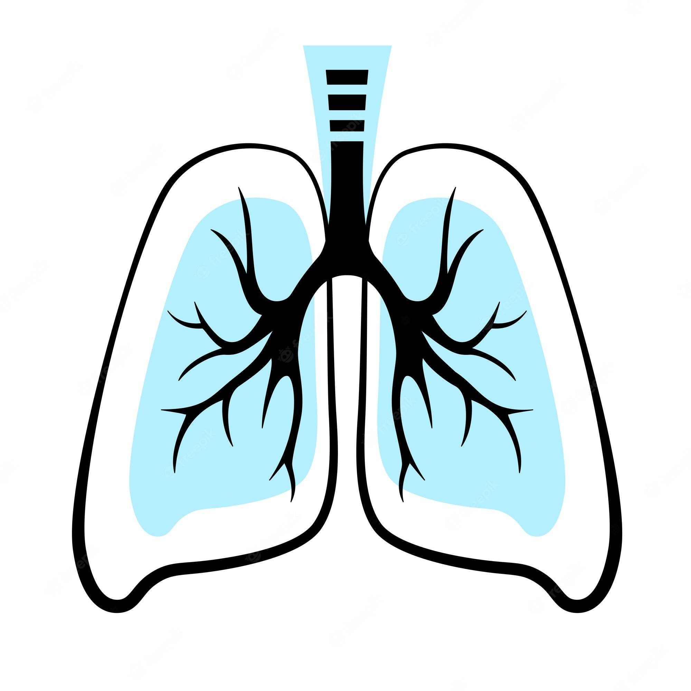
AI
DEEP LEARNING
CNN
AUDIO
COPD Detection with CNNs
Audio/Sound Classification Using Deep Learning
By the student of MTech (AI/ML):-
SHUBHAM RAJ (22070149027)
VISHWAKARMA SANDEEP (22070149031)
Under the guidance of:
Dr Shruti Patil
Prof. Ruchi Jayswal
Prof. Preksha Pareek

Slide 2

Outline
(Chronic obstructive pulmonary disease)
Change in Respiratory Sound
Problem Statement
Literature Review
Dataset
Methodology
Results
Feature Extraction
Reference
ure Extraction

Slide 3

COPD (Chronic obstructive pulmonary disease)
Chronic obstructive pulmonary disease (COPD) is a chronic inflammatory lung disease that causes obstructed airflow from the lungs.
Symptoms include breathing difficulty, cough, mucus (sputum) production and wheezing.
It's typically caused by long-term exposure to irritating gases or particulate matter, most often from cigarette smoke.
People with COPD are at increased risk of developing heart disease, lung cancer and a variety of other conditions
Learning objecti
Emphysema
Chronic Bronchitis
Irreversible Asthma
Bronchiectasis
COPD

Slide 4




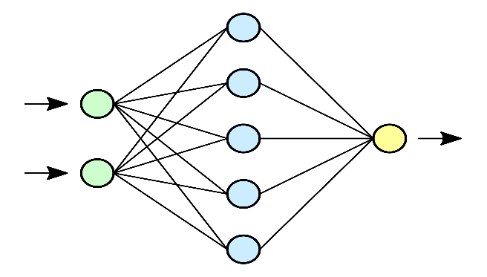

Problem Statement
To develop a more reliable, cost-effective, scalable technology to detect the COPD using deep learning.
2. Discussion – Virus, a mortal enemy
Doctor with mobile recording audio sample of patients
APP with features
COPD
Hear attack chances
Asthma
Dementia
Internet gateways/Network layer
Cloud-based Backend Layer

Slide 5

Literature Review
PAPER | YEAR | ACCURACY
Deep learning-based respiratory sound analysis for detection of chronic obstructive pulmonary disease. PeerJ | 2021 | 93%
COPD classification in CT images using a 3D convolutional neural network | 2019 | 89%
Attention Is All You Need

Slide 6
Kaggle Dataset
25
mn
Each audio file name is divided into 5 elements, separated with underscores (_).
1. Patient number (101,102,...,226)
2. Recording index
3. Chest location
a. Trachea (Tc)
b. Anterior left (Al)
c. Anterior right (Ar)
d. Posterior left (Pl)
e. Posterior right (Pr)
f. Lateral left (Ll)
g. Lateral right (Lr)
4. Acquisition mode
a. sequential/single channel (sc),
b. simultaneous/multichannel (mc)
5. Recording equipment
a. AKG C417L Microphone (AKGC417L),
b. 3M Littmann Classic II SE Stethoscope (LittC2SE),
c. 3M Litmmann 3200 Electronic Stethoscope (Litt3200),
d. WelchAllyn Meditron Master Elite Electronic Stethoscope (Meditron)
The dataset is available at Kaggle in wav format.
Dataset Link:- https://www.kaggle.com/datasets/vbookshelf/respiratory-sound-database
Content:-
This Kaggle dataset includes:
920 .wav sound files
920 annotation .txt files
A text file listing the diagnosis for each patient
A text file explaining the file naming format
A text file listing 91 names (filename_differences.txt )
A text file containing demographic information for each patient
The demographic info file has 6 columns:
1. Patient number
2. Age
3. Sex
4. Adult BMI (kg/m2)
5. Child Weight (kg)
6. Child Height (cm)

Slide 7
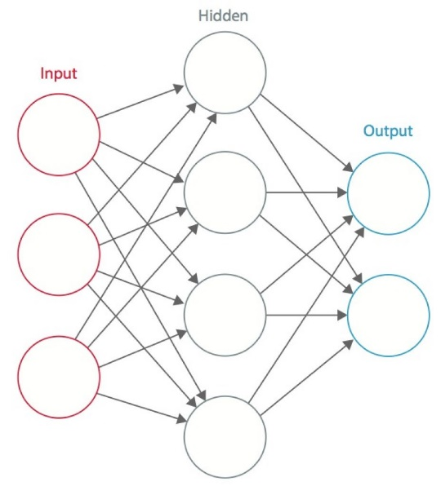


Methodology
Processing
Prediction
Audio
signal
Training Data
Testing Data
NON-COPD
COPD
Normalization
Normalization
Respiratory Audio
Feature Extraction
Feature Extraction
CNN
Augmentation
Augmentation
mfcc
mel
C_stft
C_cqt
C_cens
CNN Training
Feature Extraction

Slide 8
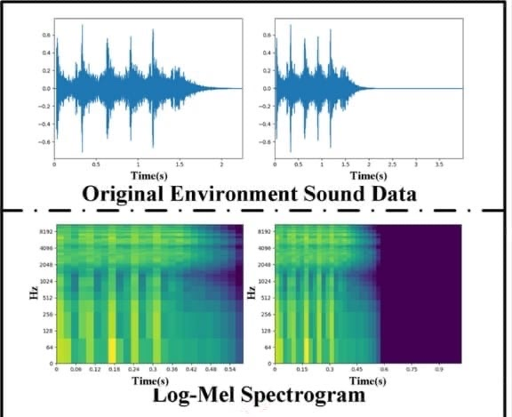
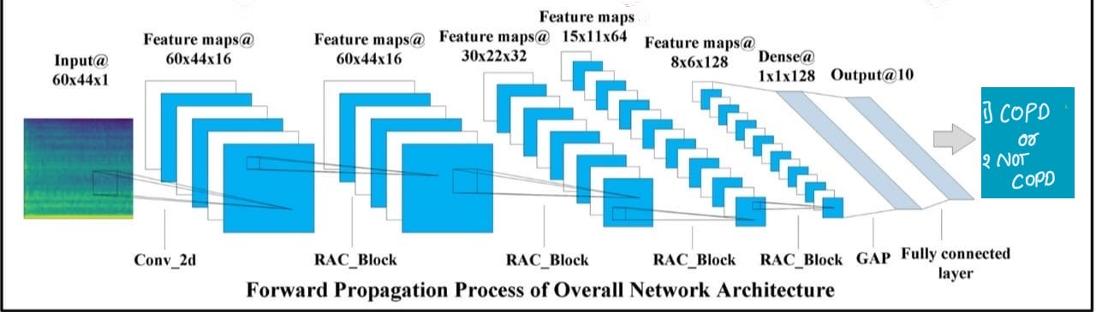

Slide 9
Results
ML ALGORITHM
LINEAR REGRESSION 55%
DECISION TREE REGRESSION 75%
Random Forest Regression 77%
Addaboost Regression 74%
Gradient Boost Regression 72%
CNN
95%
Vision Transformer

Slide 10
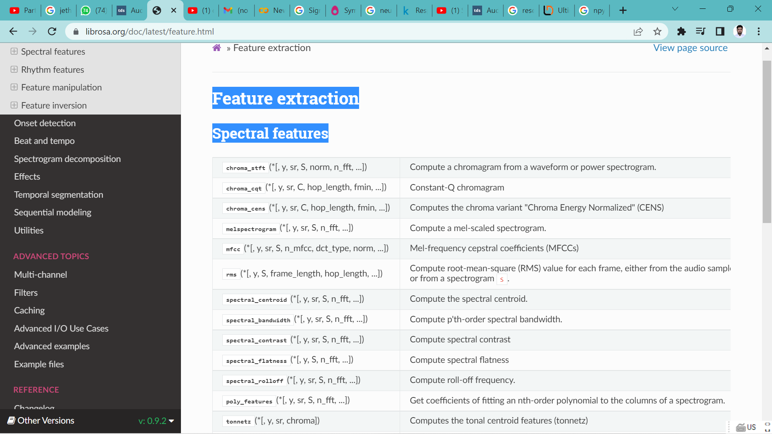
Feature Extraction
After Data Processing we will use the Librosa library in python
to extract Spectral Features from Feature extraction.
We will extract 5 features:-

Slide 11
MFCCs (Mel frequency cepstral coefficients)
Mel-frequency cepstral coefficients (MFCCs) are coefficients that collectively make up an MFC. They are derived from a type of cepstral representation of the audio clip (a nonlinear spectrum-of-a-spectrum).
The Calculation of the MFCC features is done by following steps:
The Algorithm works by framing the signal into short frames and calculating the power spectrum periodogram estimate for each frame of the signal.
Applying the Mel-space filter banks on the power spectra and sum the filters energies.
Calculate the Logarithm of the filter banks’ energies and calculate the DCT (Discrete cosine transform) of the logarithms.
4. The DCT coefficients must be between 2-13, so the algorithm will discard the others.
Sometimes the frame energy, Delta and Delta-Delta features are appended to each feature vector.

Slide 12
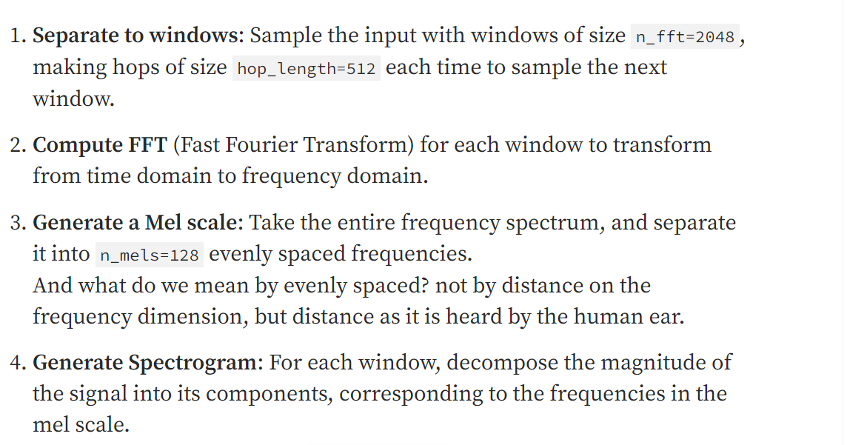
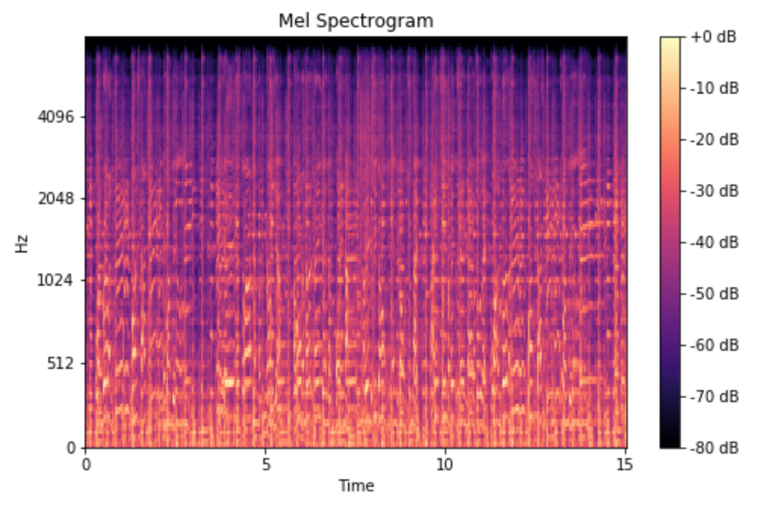
The Mel Spectrogram

Slide 13
CNN for Audio Classification
Sound Classification is one of the most widely used applications in Audio Deep Learning. It involves learning to classify sounds and to predict the category of that sound. This type of problem can be applied to many practical scenarios e.g. classifying music clips to identify the genre of the music, or classifying short utterances by a set of speakers to identify the speaker based on the voice.
Audio Classification
We will start with sound files, convert them into spectrograms, input them into a CNN plus Linear Classifier model, and produce predictions about the class to which the sound belongs.

Slide 14
Why CNN?
They can discriminate spectro-temporal patterns.
They make distinctions when sound is masked in time/frequency by other noise.
Improve the accuracy and reduce the complexity of the model.
Best Accuracy
Drawbacks
#Too Much Data is required!
Sol: Data Augmentation

Slide 15
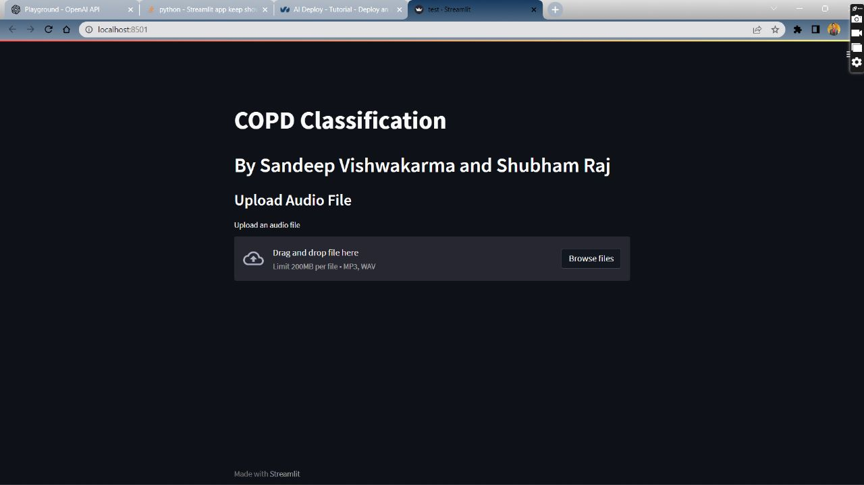
Our Website

Slide 16
Our Website
Convolutional neural networks (CNNs) have been widely adopted as the main building block for end-to-end audio classification models in the past decade, with the intention of learning direct label mapping from audio spectrograms. To better capture long-range global context, a recent trend is to add a self-attention mechanism on top of the CNN, forming a CNN-attention hybrid model. However, it is uncertain whether using a CNN is necessary, and whether using attention-only neural networks alone is sufficient to get good performance in audio categorization. In our paper, we got the answers to the questions by introducing the Audio Spectrogram Transformer (AST), the first convolution-free, purely attention-based model for audio classification. The paper evaluates AST on various audio classification benchmarks, where its accuracy on Speech Commands V2 achieves new state-of-the-art results.

Slide 17
Reference
Guidance- Dr. Saurabh Choudhary
(General physician/MBBS,MD)
Deep learning based respiratory sound analysis for detection of chronic obstructive pulmonary disease
(https://peerj.com/articles/cs-369/)
Librosa doc
https://librosa.org/doc/latest/index.html
Ahmed J, Vesal S, Durlak F, Kaergel R, Ravikumar N, Rémy-Jardin M, Maier A, Tolxdorff T, Deserno T, Handels H+1 more. 2020. COPD classification in CT images using a 3D convolutional neural network. In: Maier-Hein K, Palm C, eds. Bildverarbeitung für Die Medizin 2020—Informatik Aktuell. Wiesbaden: Springer Vieweg. 39-45
Territorial black-capped chickadee males respond faster to high- than to low-frequency songs in experimentally elevated noise conditions
(https://peerj.com/articles/3257/#fig-1)

Slide 18

THANK YOU
Thanks for

